Slide 1

Tc/BSD Hypervisor Hands-on

Slide 2
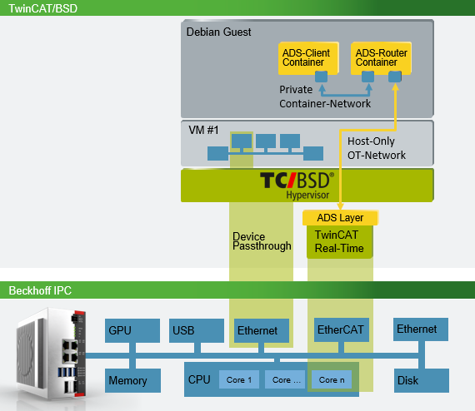
Overview
Create a Virtual Machine with 2 Docker containers for ADS Communication
Tc/BSD hosts a Debian VM using Bhyve and runs a TwinCAT project.
The Debian guest runs two Docker containers
A TcAdsRouter container to handle ADS comms between the other container and the TwinCAT run-time on the host
A Client container that sends requests to the TwinCAT run-time.

Slide 3
Steps
Preparing Tc/BSD for the VM
Installing the Linux guest
Installing Docker and other necessary programs
Building a Docker container image from a C# application
Final Set up and running the container.

Slide 4

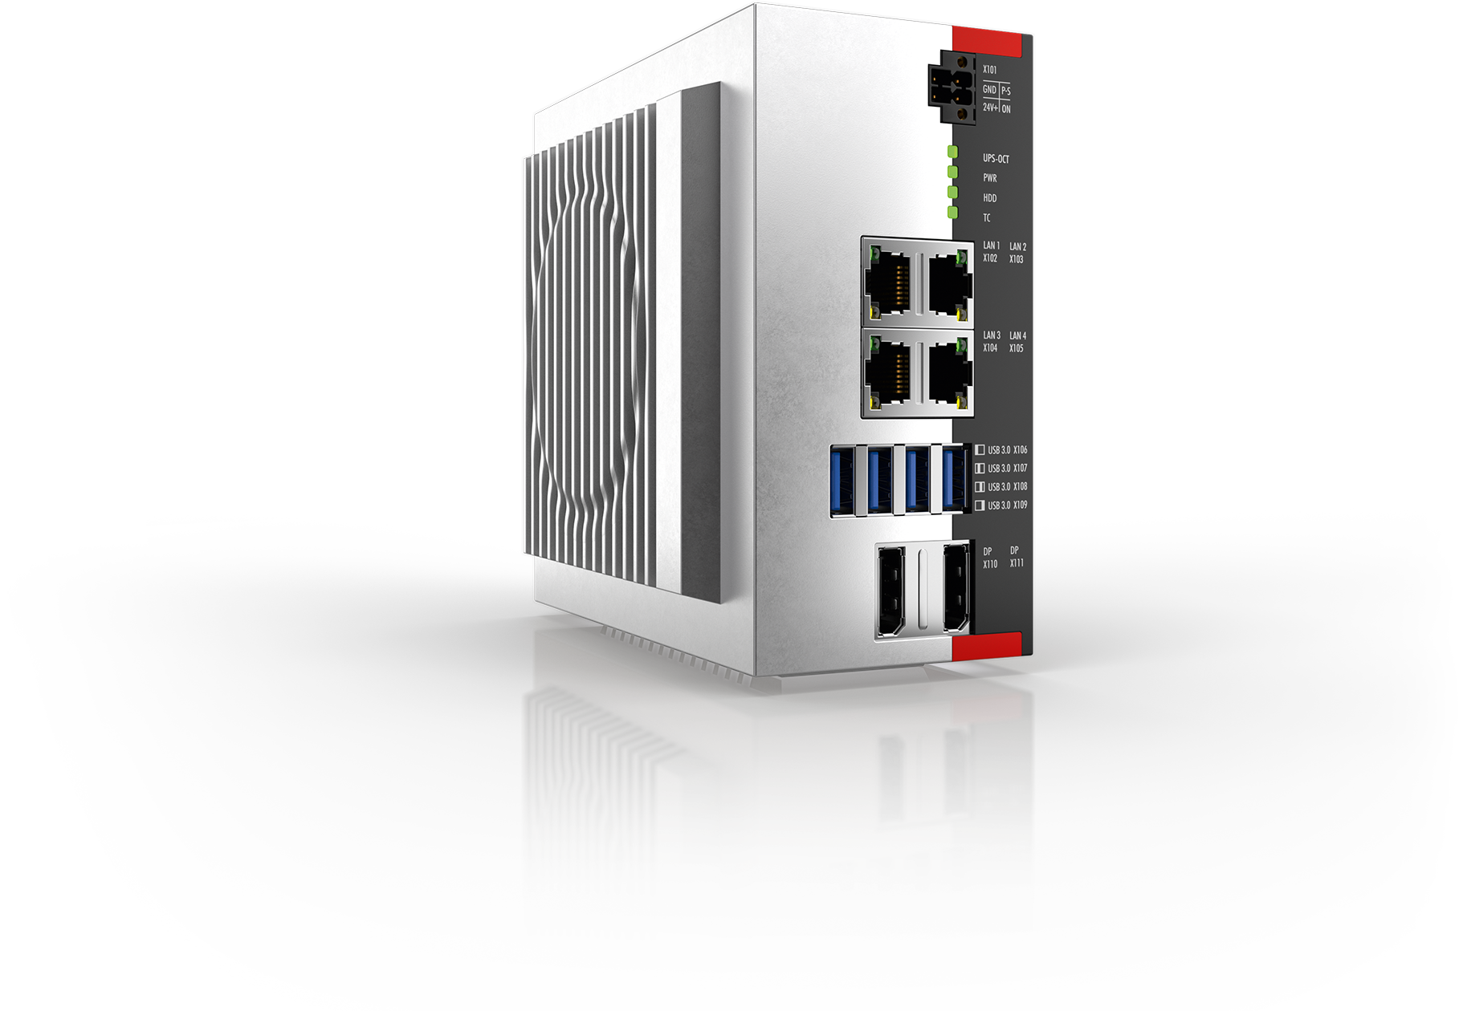
Preparing the Tc/BSD Side
Activate the Sample TwinCAT project. Do NOT put TwinCAT in run mode.
Create virtual disk image for guest
Get installation media for the Linux distribution.
Explore the vmrun.sh script
TwinCAT Real-Time
Beckhoff IPC
GPU
USB
Ethernet
EtherCAT
Ethernet
Memory
CPU
Core 1
Core …
Core n
Disk

Slide 5
Activate and Run a TwinCAT project
Activating a project onto Tc/BSD is no different than activating a project to a Windows system.
By default, only secure ADS is enabled on Tc/BSD

Slide 6
Install Bhyve using the pkg service
bhyve is not installed on Tc?BSD by default and can be downloaded from the Tc/BSD repository as part of a package.
doas pkg update
doas pkg install uefi-edk2-bhyve-bhf

Slide 7
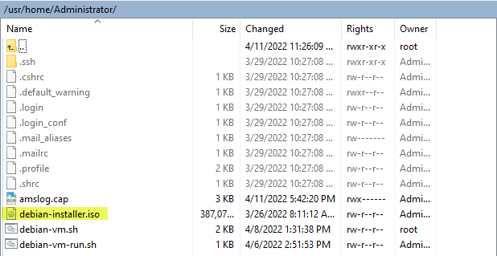
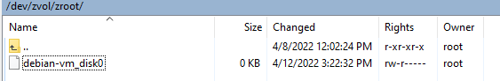
Downloading the Debain Installation Disk
Create directory for vm files
doas mkdir $home/vms
doas mkdir $home/vms/debian
Download the iso file from Debian’s network
doas fetch -o “$HOME/vms/debian/debian-installer.iso"
https://cdimage.debian.org/debian-cd/current/amd64/iso-cd/debian-11.3.0-amd64-netinst.iso
Create the virtual disk image file
doas zfs create -V 10G -o volmode=dev “zroot/debian-vm_disk0”

Slide 8
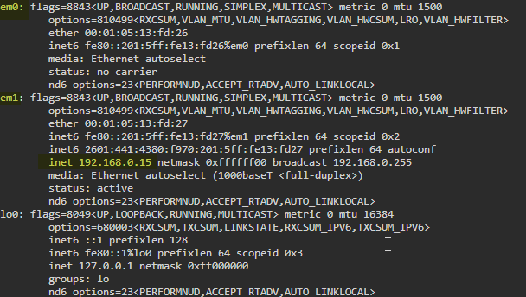
Set up the Network Configuration
We will need to create a bridge between the guest vm and the host computer to allow network communication to the guest.
First, we need to know the name of the port we are using
Enter: ifconfig
Find the adapter name that has the “inet” field.
It should be em0/1 or igb0/1. Write it down or make a note.

Slide 9
Set up the Network Configuration – Creating a Bridge Interface
To create the bridge and have it persist between power cycles of the system, we will add it to the rc.conf file.
doas ee /etc/rc.conf
Add the following lines to the file:
cloned_interfaces=“bridge0”
ifconfig_bridge0=“inet <ip address> netmask 255.255.255.0”
Press Esc then ‘a’ to exit, and ‘a’ again to save changes.

Slide 10
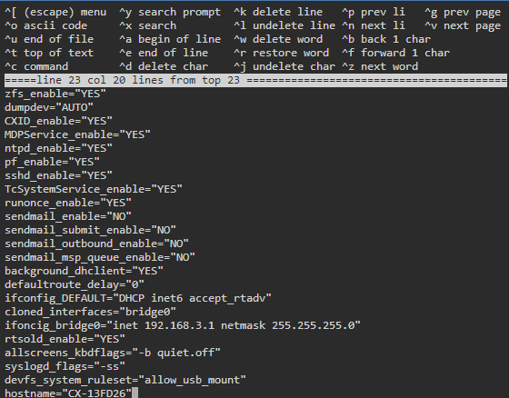

Slide 11
Set up the Network Configuration - Firewall
Set up firewall rules for the VM and ADS communication
/etc/pf.conf is the default configuration file for the BSD firewall.
We have another file in /etc/pf.conf.d/ named bhf for Beckhoff specific rules
Notes:
You do not have to make it look nice with the added comment like I did in the screen shot, it won’t make the communication any faster, or stable.

Slide 12
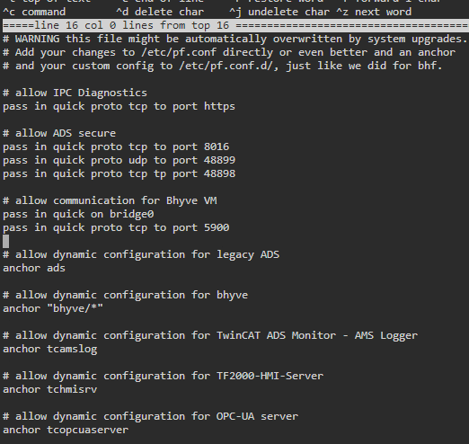
Set up the Network Configuration – Firewall Cont.
To open the configuration file use the command
doas ee /etc/pf.conf.d/bhf
We can add the following lines to that file to allow Communication to the VM
pass in quick on bridge0
pass in quick proto tcp to port 5900
Enable unencrypted ADS as well
pass in quick proto tcp to port 48898
Exit and save
To enable the rules use the command
doas pfctl –f /etc/pf.conf.d/bhf

Slide 13
Exploring the debian-vm.sh Script
For customers to have the option of creating their own custom guest OSs, they are going to need some scripting knowledge to get it running at startup. Especially if they want to try to create a Windows guest.
For starting the VM we can let the script debian-vm.sh handle the rest.
The script is meant to specifically launch a bhyve instance for a Debian VM.

Slide 14
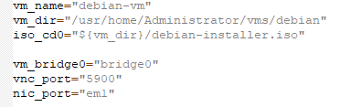
Exploring the script - variables
The variables here are mostly paths to the files and directories we created.
vm_name is the given to the image file.
Iso_cd0 is the location of the previously downloaded installer cd.
vnc_port will be the port we connect to using UltraVNC to interface with the Debian guest

Slide 15
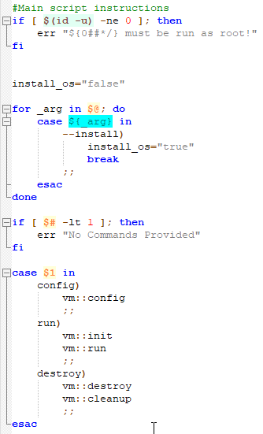
Exploring the Script – The Main Instructions Section
After creating the variables, this is the next part to execute.
Its purpose is first to make sure the script is run with Admin rights, and to direct the flow to the correct command.
When calling the script, the arguments tell it what task to perform.
Config runs the rest of the configuration steps.
Run will call Bhyve to create the VM
Destroy deletes the instance and reverses the steps performed in Config.

Slide 16
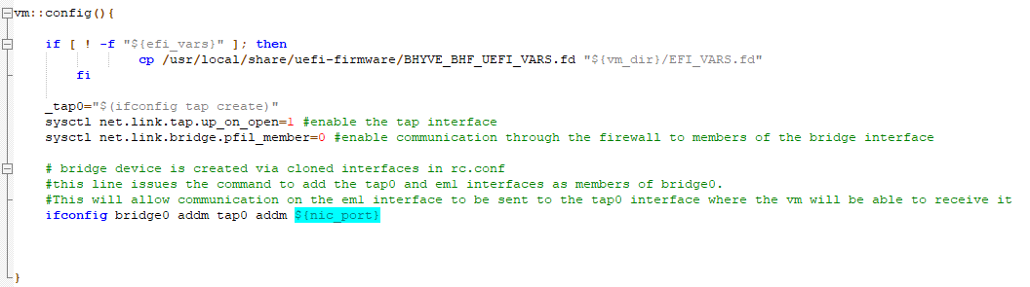
Exploring the Script - Configuration
Notes:
RED

Slide 17
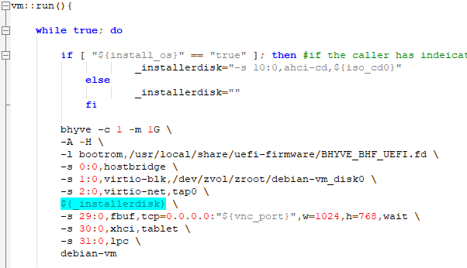
Exploring the Script – Starting Bhyve
Bhyve is the command. We’re are passing 1 CPU core and 1GB of Memory.
-A tells Bhyve to create an ACPI table, and –H to yield the CPU thread when a halt instruction is detected.
-l is passing the boot firmware.
0:0 is the hostbridge.
1:0 is the virtual disk created earlier.
2:0 is the tap interface created when the config command was called. Any network traffic to the VM will go through it.
_installerdisk is passed as a cd device if installing, otherwise it is blank.
29:0 is the framebuffer it is passing the graphical information to the VNC port and waiting for a connection to start booting.
30:0 will enable mouse input through the VNC
31:0 addresses the LPC ISA bridge
debian-vm will be the name of the VM instance.
Notes:
Byhve is a BSD Hypervisor software. To use Bhyve, some hardware needs to be passed to the VM guest. We can tell Bhyve what devices we want to create, their types, what PCI bus port to address the device in the VM, and where the device we are passing is on the host.

Slide 18
Steps
Setting up Tc/BSD for the VM
Installing the Linux guest
Installing Docker and other necessary programs
Building a Docker container image from a C# application
Final Set up and running the container

Slide 19
Launch the VM
debian-vm.sh will handle the rest of the configuration. Use the command
doas sh debian-vm.sh config
In order to install the vm we will call that script the --install argument.
To run the script and have the VM boot to the Debian Installer, enter the command:
doas sh debian-vm.sh run –-install
Notes:
Work with

Slide 20
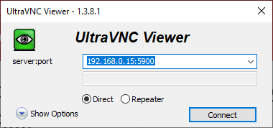
Connect to the VM using a VNC viewer
Open Ultra VNC Viewer on your laptop
Connect to <ipaddress>:5900

Slide 21
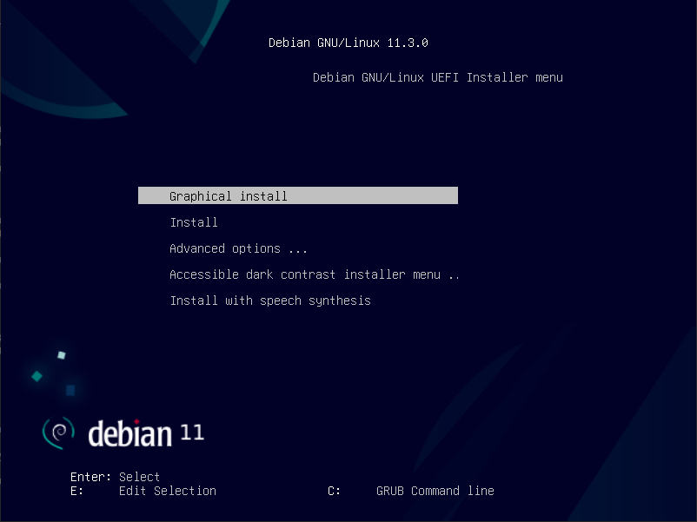
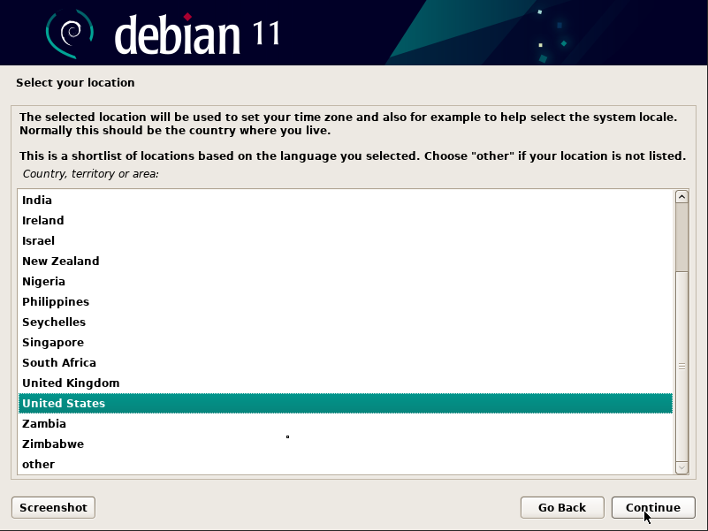
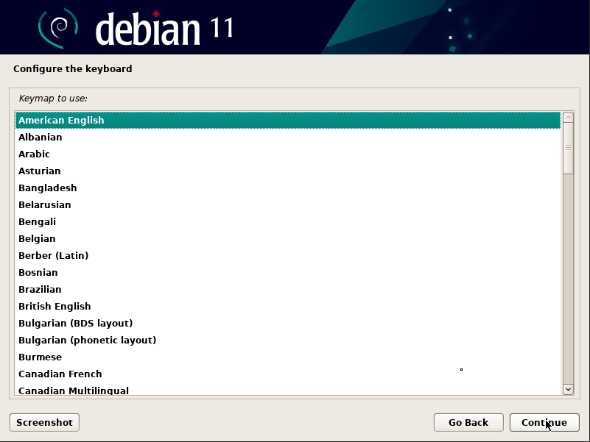
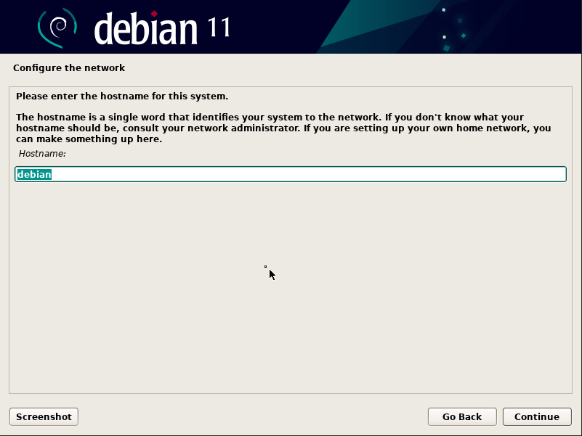
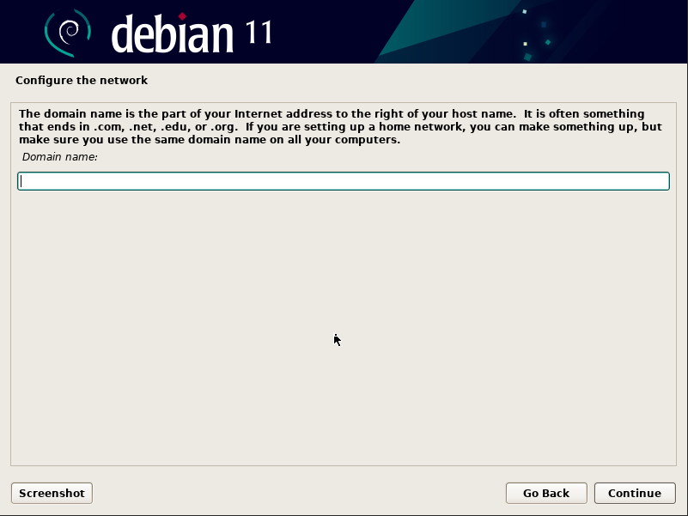
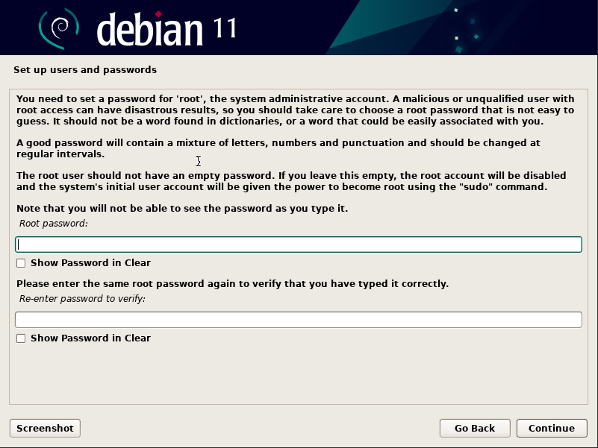
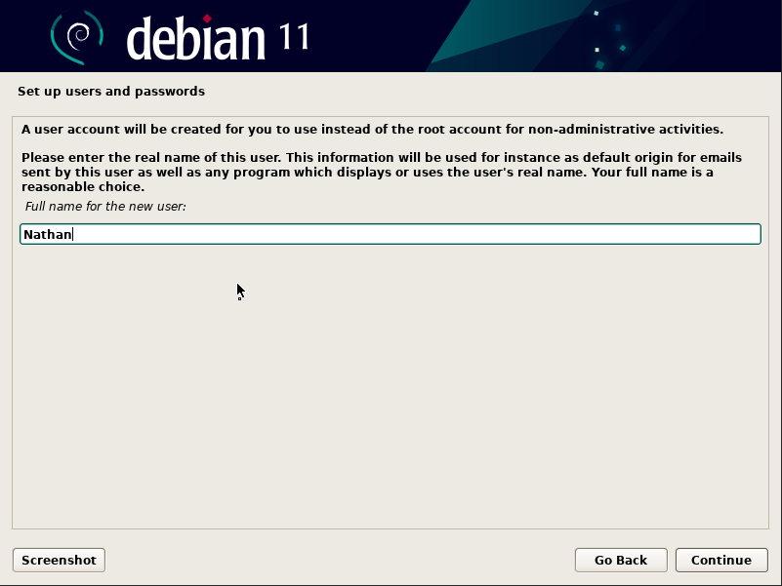
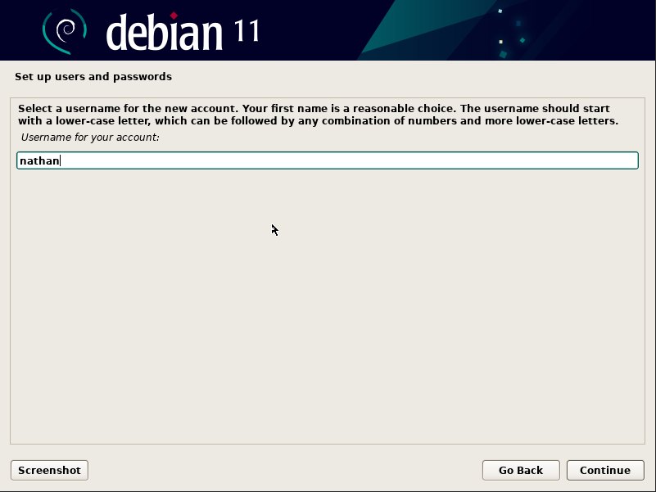
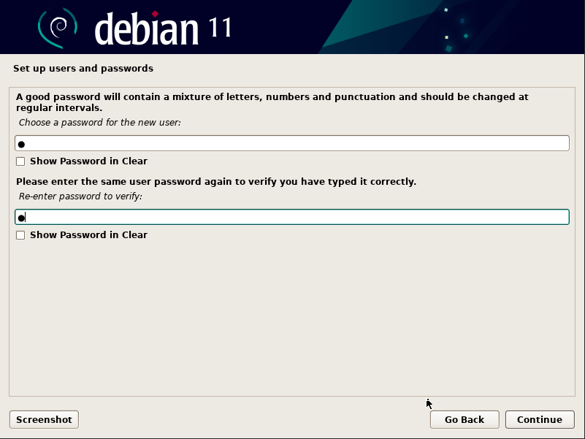
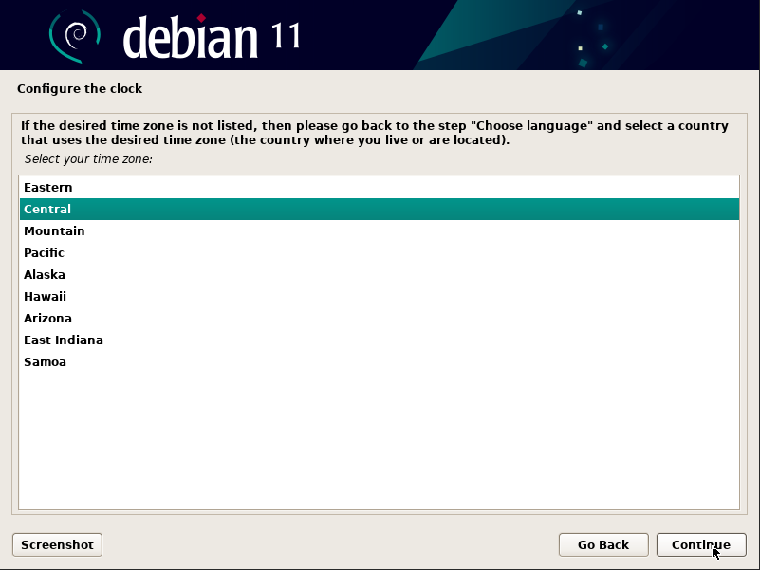
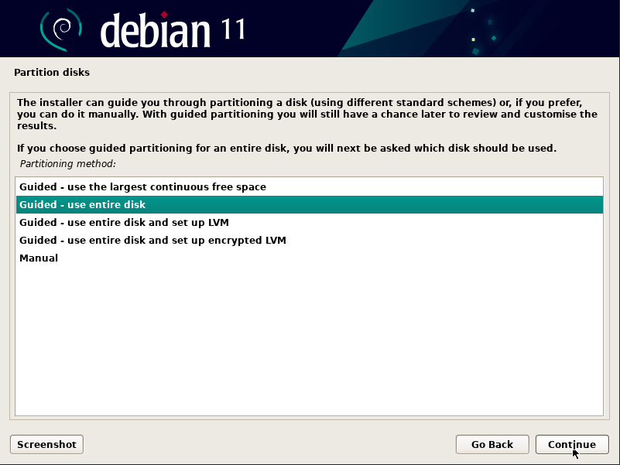
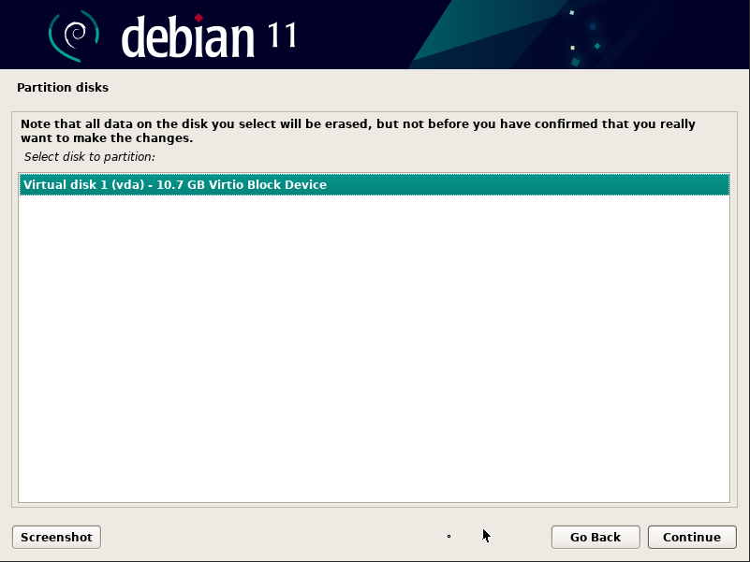
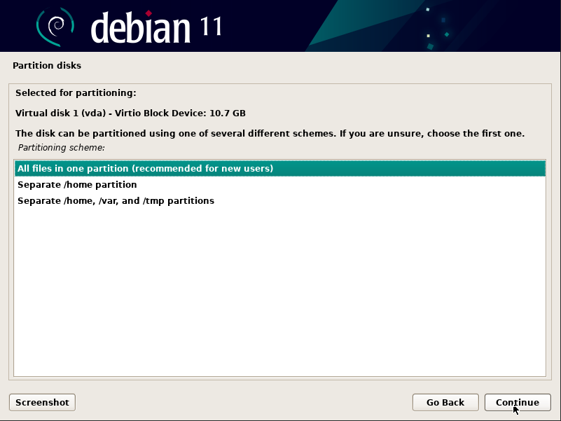
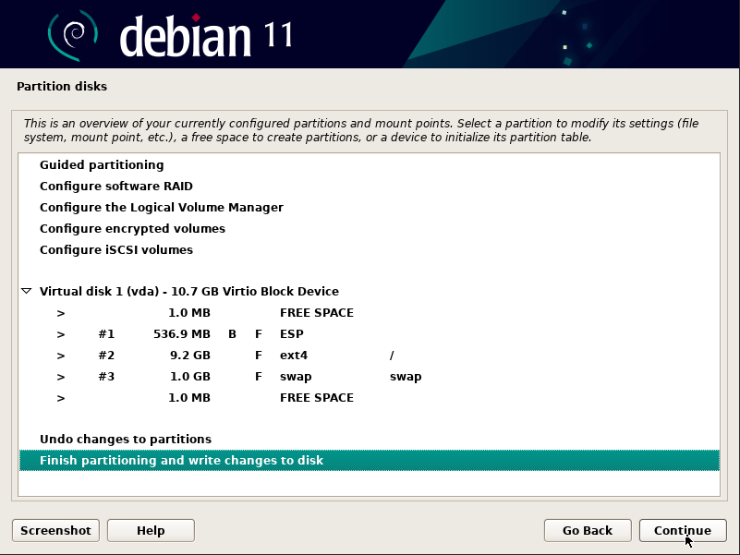
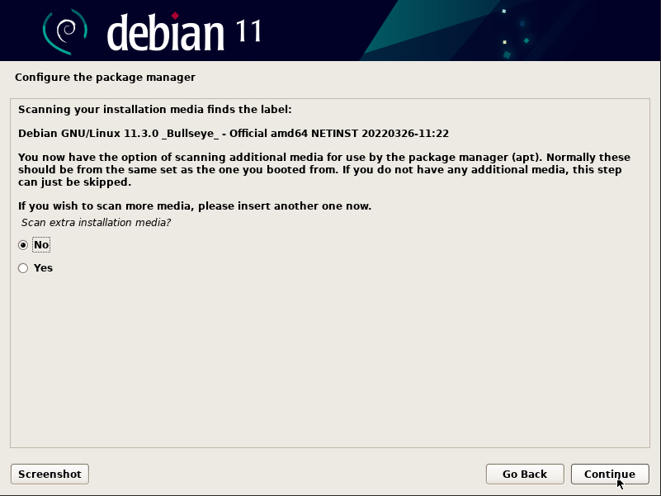
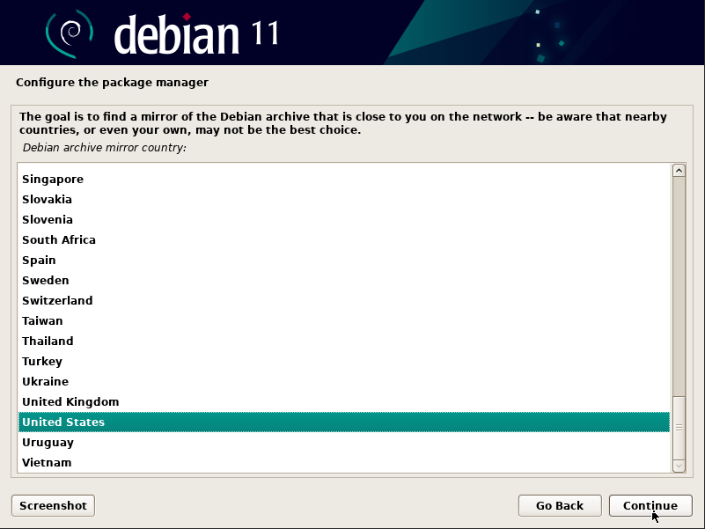
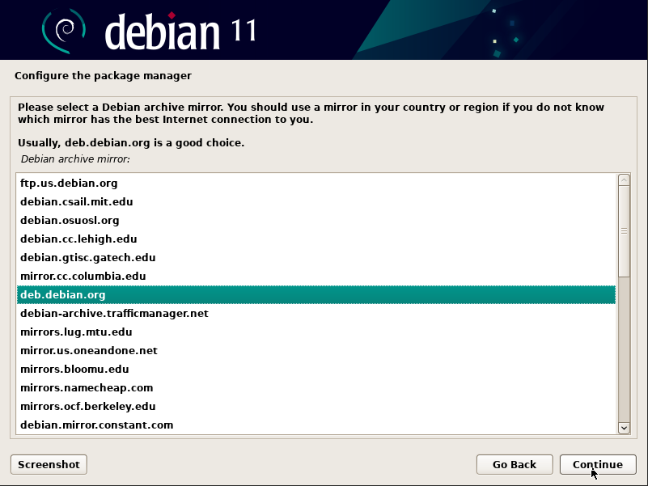
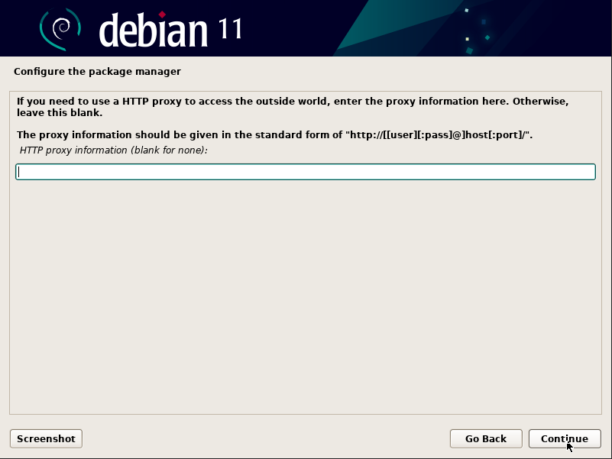
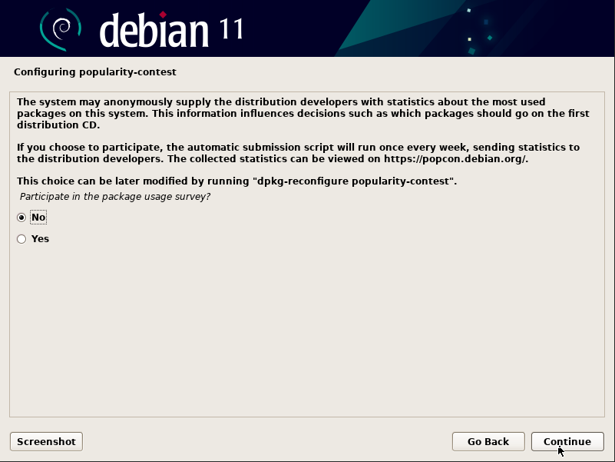
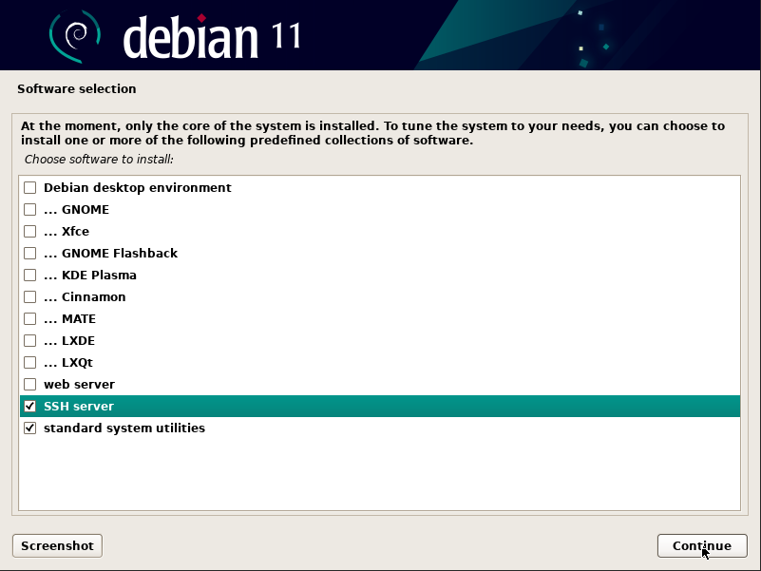
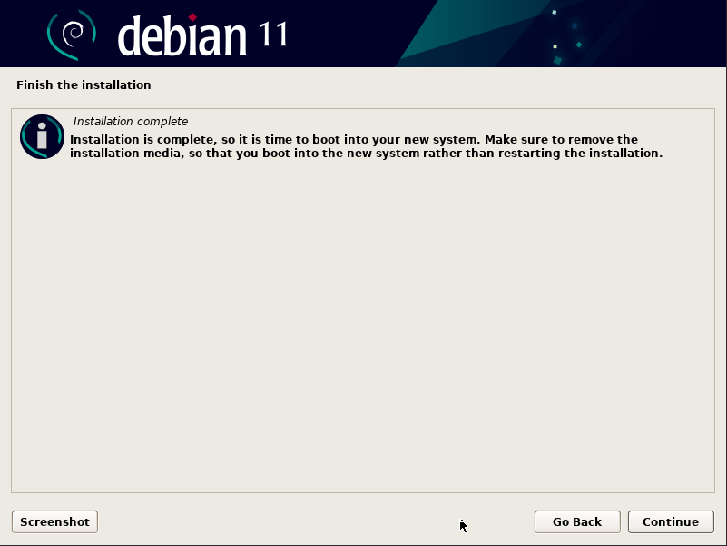
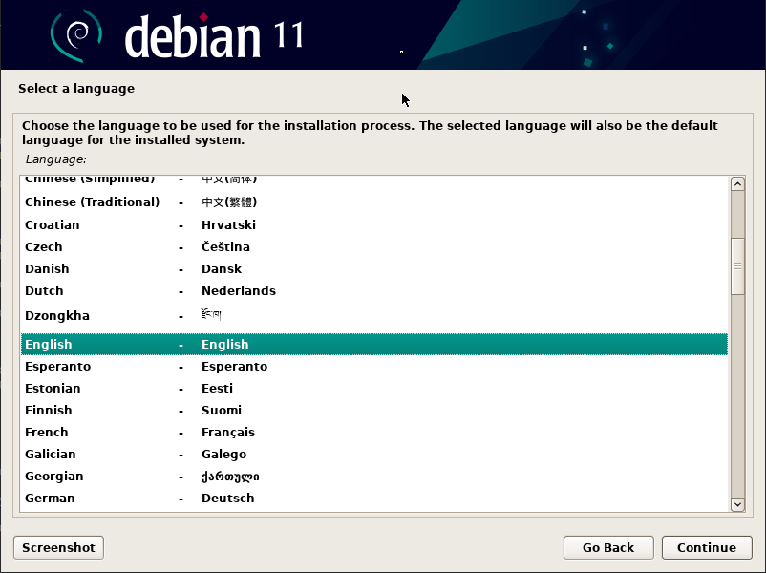
Follow Debian Installer
Notes:
While the installation process is under way, have the class activate the TwinCAT project onto the Tc/BSD host.

Slide 22
Once the installation process is finished, call the script again without the –install argument:
doas sh debian-vm.sh run
Then Connect via Ultra VNC again.

Slide 23
Steps
Setting up Tc/BSD for the VM
Installing the Linux guest
Installing Docker and other necessary programs
Building a Docker container image from a C# application
Final Set up and running the container

Slide 24




Preparing the Linux Guest
Connect to the VM using PuTTY
Install dotnet 6.0 SDK
Install packages required to install and run Docker.
Install Docker
TwinCAT/BSD
Debian Guest
VM #1
Host-Only OT-Network
Device Passthrough
TwinCAT Real-Time
Beckhoff IPC
EtherCAT
Ethernet
GPU
USB
Ethernet
EtherCAT
Memory
CPU
Core …
Core n
Disk
Core 1
Core n

Slide 25

A Note About Working in Debian
For those who are used to working in Tc/BSD but not Debian:
sudo = doas
apt = pkg
ifconfig is deprecated and not installed by default. Use the command “ip”
ip addr will perform the same function as ifconfig
Easy Editor is not installed by default, instead we will be using nano, which is a bit more robust without vims opaque UE.

Slide 26
Install important packages
Get Microsoft signing key and repository for dotnet:
cd $Home
sudo wget https://packages.microsoft.com/config/debian/11/packages-microsoft-prod.deb -O packages-microsoft-prod.deb
sudo dpkg -i packages-microsoft-prod.deb
sudo rm packages-microsoft-prod.deb
sudo apt update

Slide 27
Install Important Packages
Install packages needed to install and use docker
sudo apt install -y apt-transport-https ca-certificates curl gnupg2 software-properties-common dotnet-sdk-6.0 unzip
Get the Docker repository
sudo curl -fsSL https://download.docker.com/linux/debian/gpg | sudo apt-key add –
sudo add-apt-repository "deb [arch=amd64] https://download.docker.com/linux/debian $(lsb_release -cs) stable"
Install Docker
sudo apt update
sudo apt-cache policy docker-ce
sudo apt install -y docker-ce

Slide 28
Steps
Setting up Tc/BSD for the VM
Installing the Linux guest
Installing Docker and other necessary programs
Building a Docker container image from a C# application
Final Set up and running the container

Slide 29


Creating the Docker Containers
Download sample project from the Beckhoff GitHub
Edit the settings files for the containers
Build the images
TwinCAT/BSD
Debian Guest
ADS-Client Container
ADS-Router Container
VM #1
Host-Only OT-Network
Device Passthrough
TwinCAT Real-Time
Beckhoff IPC
GPU
USB
Ethernet
EtherCAT
Ethernet
Memory
CPU
Core 1
Core …
Core n
Disk

Slide 30
Dowloading the Application for the Container
Download GitHub samples from the Beckhoff GitHub
sudo wget https://github.com/Beckhoff/TF6000_ADS_DOTNET_V5_Samples/archive/refs/heads/main.zip
sudo unzip main.zip
sudo rm main.zip

Slide 31
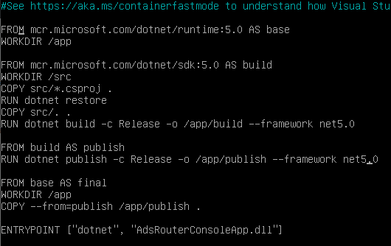
Building the AdsRouterConsole Container
Build container for the AdsRouterConsole
cd $HOME/TF6000_ADS_DOTNET_V5_Samples-main/Sources/RouterSamples/AdsRouterConsoleApp/
sudo docker build -t ads-router-console --target=final --file Dockerfile .
The period at the end is meant to be there, do not forget it.

Slide 32
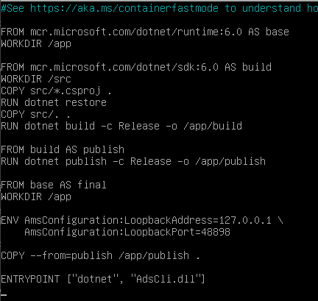
Building the AdsClientConsole Container
Build the container for the AdsClientConsole
cd $HOME/TF6000_ADS_DOTNET_V5_Samples-main/Sources/ClientSamples/AdsCli
sudo docker build -t ads-cli-client:latest .
The period at the end is important, do not forget it.
Double Check that our images were built
sudo docker images
Should show 1 entry for ads-router-console, 1 for client-console
Notes:
Add screenshot

Slide 33
Steps
Setting up Tc/BSD for the VM
Installing the Linux guest
Installing Docker and other necessary programs
Building a Docker container image from a C# application
Final Set up and running the container

Slide 34
Final Steps
Edit routes for the AdsRouterConsole container
Add the AdsRouterContainer to the routing table of the host’s TwinCAT router.
Run the containers.
TwinCAT/BSD
Debian Guest
ADS-Client Container
ADS-Router Container
Private Container-Network
VM #1
Host-Only OT-Network
ADS Layer
Device Passthrough
TwinCAT Real-Time
Beckhoff IPC
GPU
USB
Ethernet
EtherCAT
Ethernet
Memory
CPU
Core 1
Core …
Core n
Disk

Slide 35
Creating the Router Table for the AdsRouterConsole Container
Return to AdsRouterConsoleApp directory
cd $HOME/TF6000_ADS_DOTNET_V5_Samples-main/Sources/RouterSamples/AdsRouterConsoleApp/
Copy router table sample from the “src” directory to the current directory.
sudo cp ./src/settings-bridged-network.env ./settings.env
Open the file with a text editor
sudo nano settings.env

Slide 36
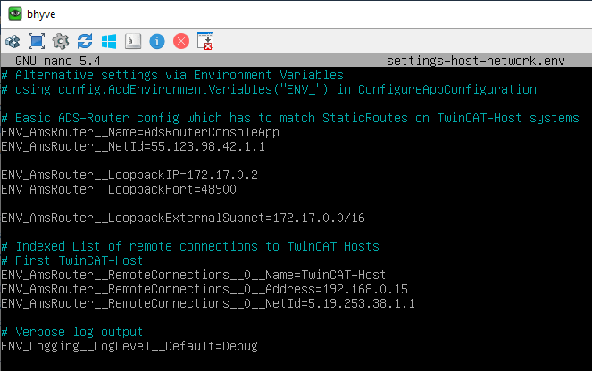
Cont.
Notes:
The Section under “Indexed List of remote connections to TwinCAT Hosts needs to be edited to match the information of the BIM stand.
The Loopback section shouldn’t need to be changed, but the port and ip address are important to take note of.
The Routers AMS Netid should be fine as it is, but it can be changed. That should be written down.

Slide 37
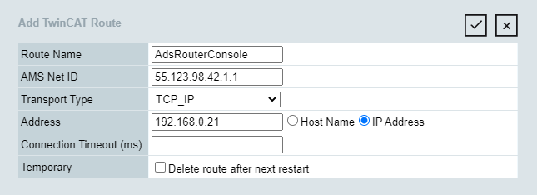
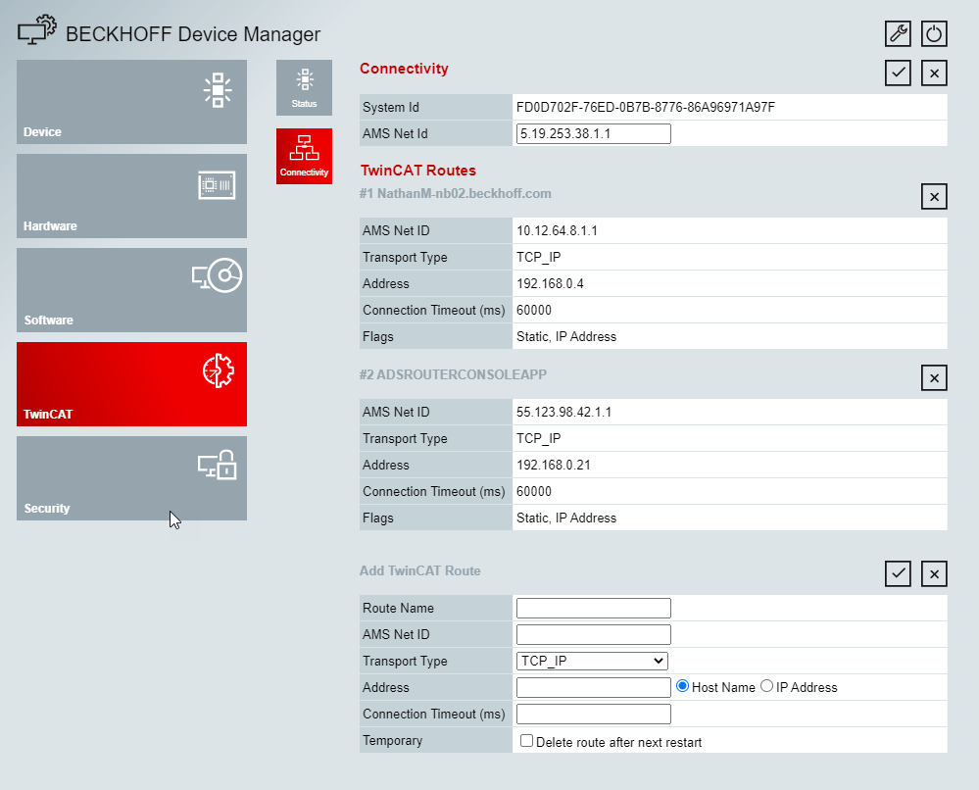
Adding the AdsRouterConsole Container to the Host Routing Table
Get the guest’s IP address
ip addr
On your ENG PC, connect to the Host’s Web Server: https://<ipaddress>
Go to the Device Manager then Navigate to the Network page under TwinCAT
Enter the routing information of the container and save.

Slide 38
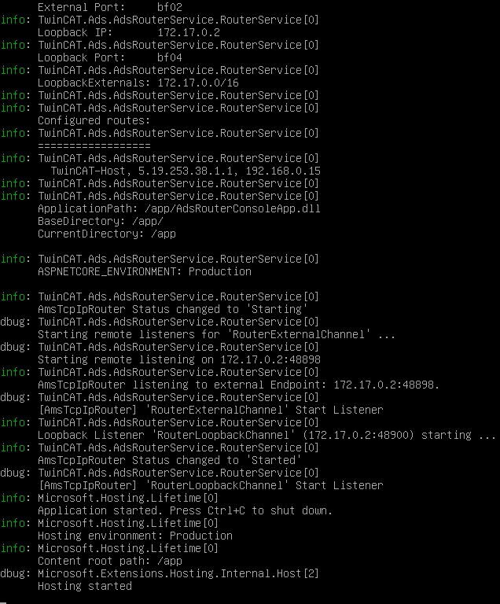
Run the Containers
Make sure TwinCAT is in run mode on the host and the PLC program is started.
Use doas TcSysExe.exe --run to restart in run mode
Start the AdsRouterConsole container
sudo docker run -it --rm --name adsrouter --env-file=settings.env --ip 172.17.0.2 -p 48898:48900 ads-router-console

Slide 39
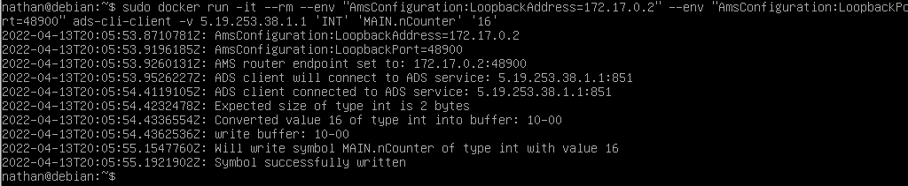
Cont.
Switch to a new tty console
Use Ctrl+Alt+F# to switch to up to 6 consoles. (i.e. Ctrl+Alt+F2 will switch to console 2. We are in console 1 by default)
Start the AdsClientConsole container.
docker run -it --rm --env "AmsConfiguration:LoopbackAddress=172.17.0.2" --env "AmsConfiguration:LoopbackPort=48900" ads-cli-client -v 5.76.88.215.1.1 'INT' 'MAIN.nCounter' '16’
Notes:
Once started the Client should write to the TwinCAT host successfully and a success message should be output.

Slide 40
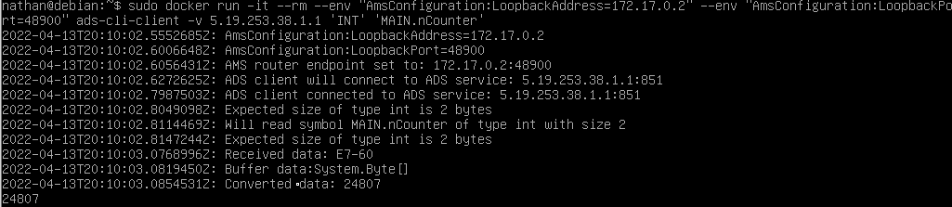
Cont.
To read from TwinCAT remove the final argument: docker run -it --rm --env "AmsConfiguration:LoopbackAddress=172.17.0.2" --env "AmsConfiguration:LoopbackPort=48900" ads-cli-client -v 5.76.88.215.1.1 'INT' 'MAIN.nCounter'

Slide 41
Wrap-up
In the event that the vm crashes, or is exited improperly, it will be necessary to destroy the current instance from the host.
The debian-vm.sh script has a function for removing the configurations it added and destroy the current instance of the vm. Call it with the destroy argument:
doas sh debian-vm.sh destroy

Slide 42
Wrap-up Cont.
Next delete the lines we added to /etc/rc.conf and /etc/pf.conf.d/bhf
Then enter the command
zfs destroy zroot/Debian-vm_disk0

